Slide 1
Terrestrial Ecosystem Models

Slide 2


Slide 3
Different types of models
Land surface models
Terrestrial biosphere models
Terrestrial ecosystem models
Dynamic vegetation models
General circulation models
Earth system models

Slide 4
Different types of models
Land surface models
Terrestrial biosphere models
Terrestrial ecosystem models
Dynamic vegetation models
General circulation models
Earth system models
Generally thought of to be the same thing:
“numerical models that solve the coupled fluxes of water, energy, and carbon between the land surface and atmosphere, within a context of direct and indirect human forcings and ecological dynamics” (Fisher and Koven, 2020)

Slide 5
Different types of models
Land surface models
Terrestrial biosphere models
Terrestrial ecosystem models
Dynamic vegetation models
General circulation models
Earth system models
A type of land surface model where the type of vegetation in a given location can change

Slide 6
Different types of models
Land surface models
Terrestrial biosphere models
Terrestrial ecosystem models
Dynamic vegetation models
General circulation models
Earth system models
Models of atmospheric pools and fluxes used to predict climate dynamics

Slide 7
Different types of models
Land surface models
Terrestrial biosphere models
Terrestrial ecosystem models
Dynamic vegetation models
General circulation models
Earth system models
A model that couples together models of different components of the Earth system (e.g., land, ocean, atmosphere, sea ice, etc.)

Slide 8
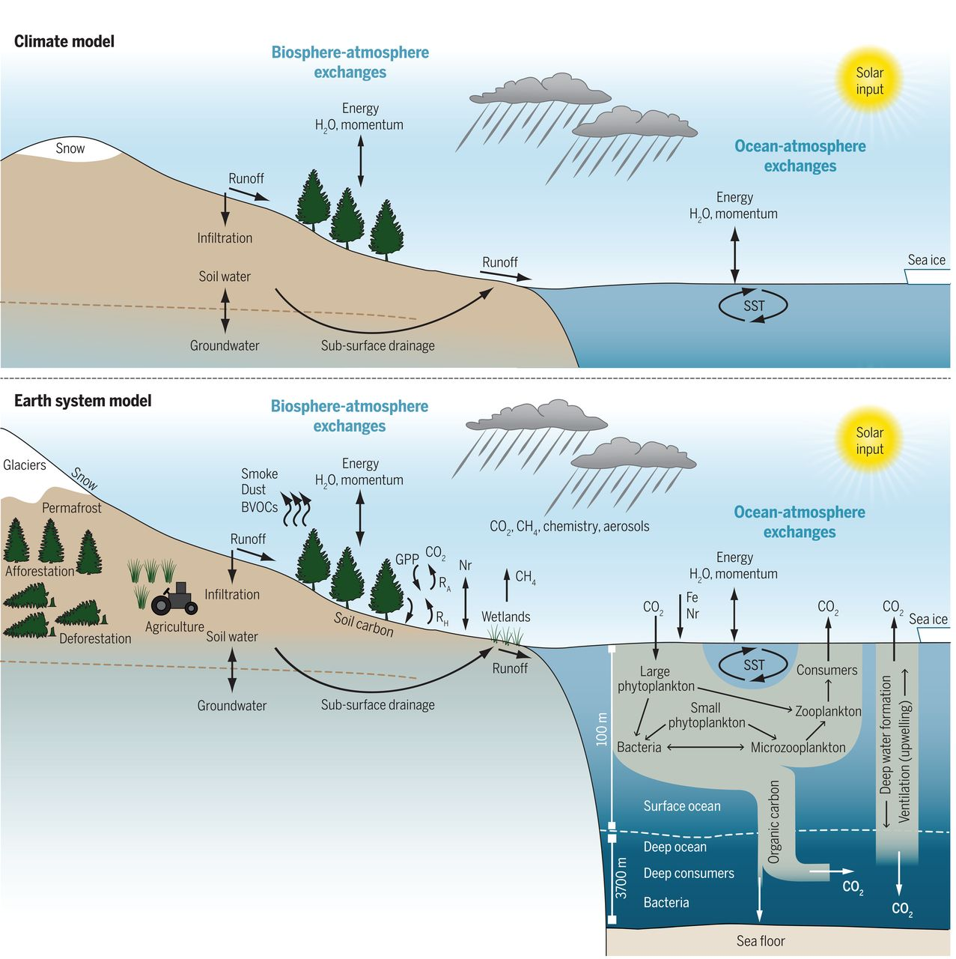
Bonan and Doney (2018)

Slide 9
This class will focus on land surface/terrestrial biosphere/terrestrial ecosystem models
Land surface models
Terrestrial biosphere models
Terrestrial ecosystem models
Dynamic vegetation models
General circulation models
Earth system models
“numerical models that solve the coupled fluxes of water, energy, and carbon between the land surface and atmosphere, within a context of direct and indirect human forcings and ecological dynamics” (Fisher and Koven, 2020)

Slide 10
Why were these models originally developed?
Plant biophysical responses have an appreciable effect on climate
Terrestrial biogeochemical responses have an appreciable effect on climate through their impact on the carbon cycle

Slide 11
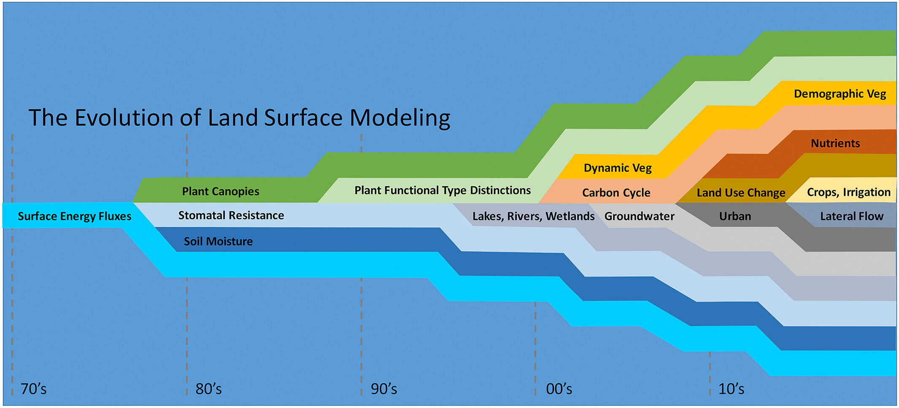
Fisher and Koven (2020)

Slide 12
How do these influence biophysical and biogeochemical processes?
Fisher and Koven (2020)

Slide 13
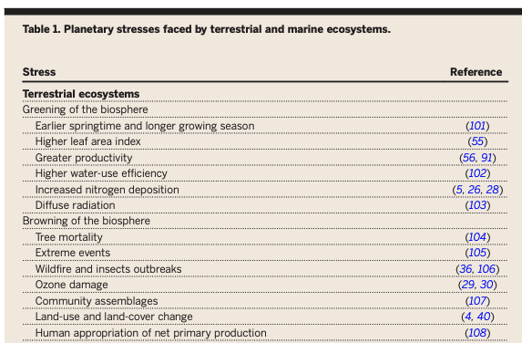
Bonan and Doney (2018)

Slide 14
Fisher and Koven’s 3 grand challenges
Managing and understanding process complexity
Heterogeneity and the dimensionality of the land surface
Projecting the temporal and spatial dynamics of model parameters

Slide 15
Fisher and Koven’s 3 grand challenges
Managing and understanding process complexity
Heterogeneity and the dimensionality of the land surface
Projecting the temporal and spatial dynamics of model parameters

Slide 16
“the scope and complexity of land surface models have reached the point that no individuals are able to comprehensively understand all facets of any one model”

Slide 17
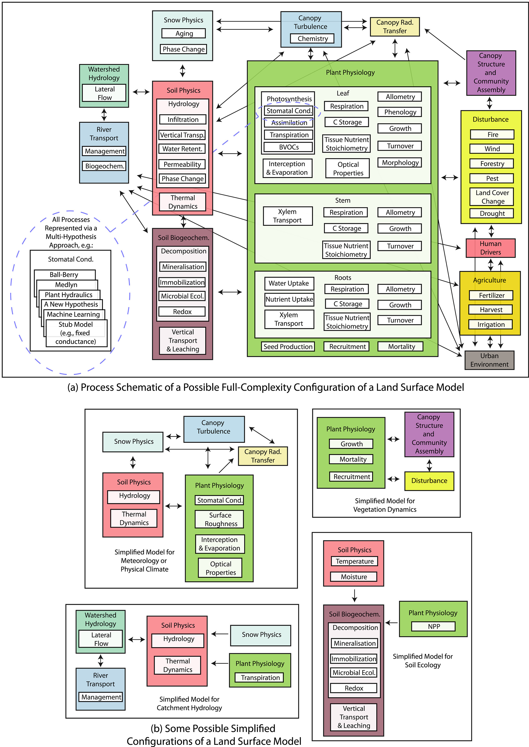
Land surface models can be super complex
Fisher and Koven (2020)

Slide 18
Modular complexity as a strategy for understanding models
Fisher and Koven (2020)

Slide 19
Fisher and Koven (2020)

Slide 20
Fisher and Koven’s 3 grand challenges
Managing and understanding process complexity
Heterogeneity and the dimensionality of the land surface
Projecting the temporal and spatial dynamics of model parameters

Slide 21
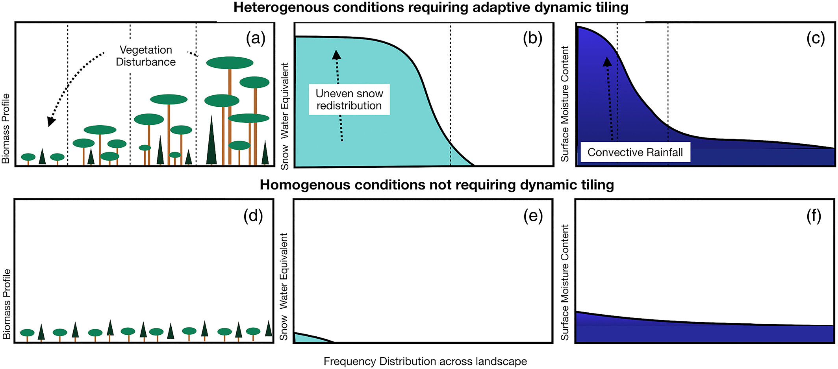
Fisher and Koven (2020)

Slide 22
Fisher and Koven’s 3 grand challenges
Managing and understanding process complexity
Heterogeneity and the dimensionality of the land surface
Projecting the temporal and spatial dynamics of model parameters

Slide 23
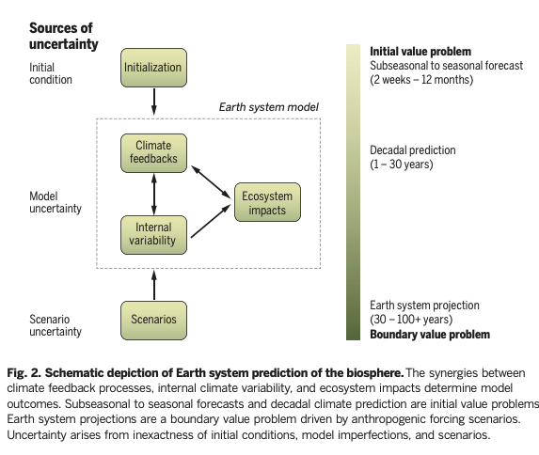
Bonan and Doney (2018)

Slide 24
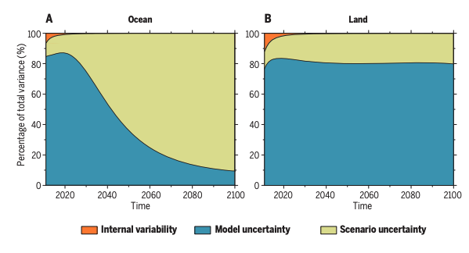
Bonan and Doney (2018)

Slide 25
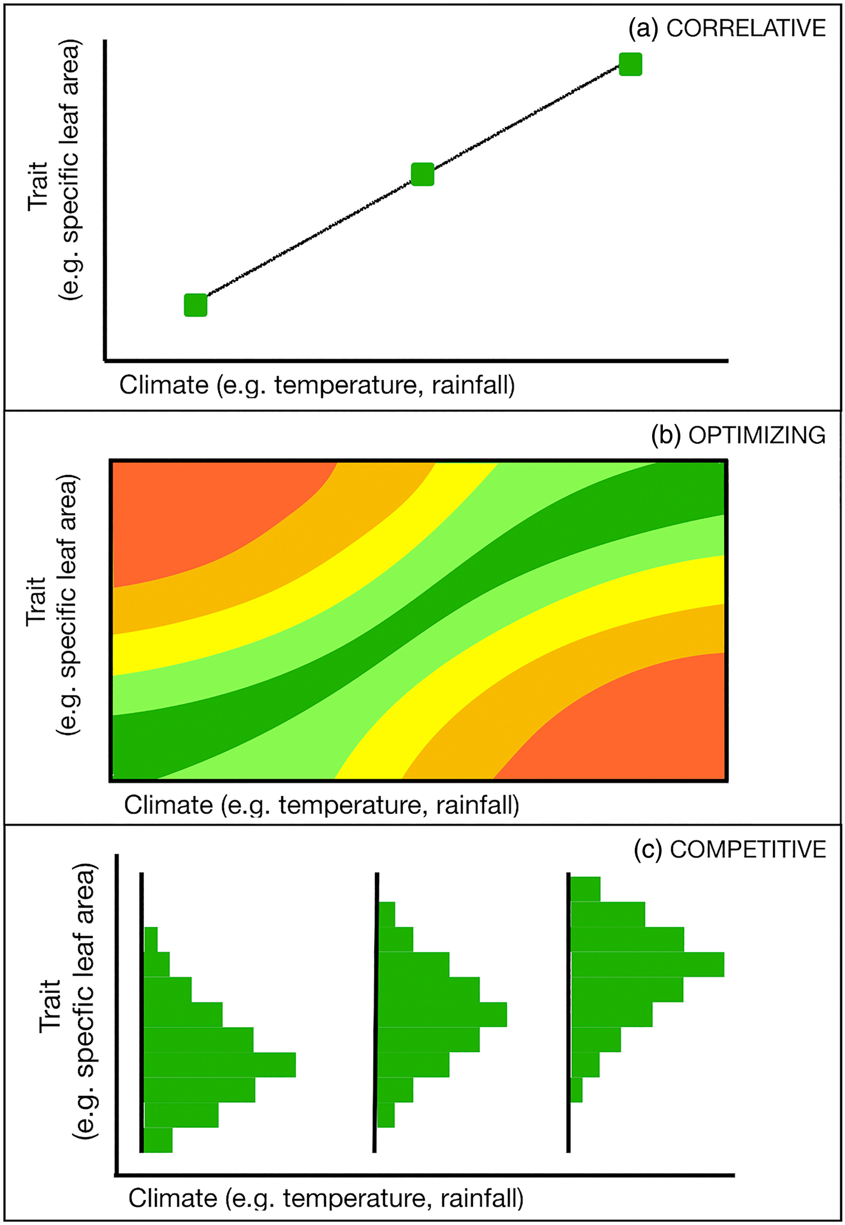
Fisher and Koven (2020)

Slide 26
In this class, we’re taking a slightly different approach than “typical modelers”
We’re starting from scratch to build a model from the beginning
Not using a pre-developed model
What are the positives/negatives of this approach?

